Slide 1
Adversarial Search and Game Playing

Slide 2
Topics
Game playing
Game trees
Minimax
Alpha-beta pruning
Examples

Slide 3
What & Why
Games are a form of multi-agent environment
What do other agents do and how do they affect our success?
Cooperative vs. competitive
Competitive multi-agent environments give rise to adversarial search a.k.a. games
Why study games?
Fun; historically entertaining
Interesting subject of study because they are hard
Easy to represent and agents restricted to small number of actions

Slide 4
Game-Playing Agent
sensors
?
environment
agent
Environment
actuators

Slide 5
Types of games
deterministic
chance
perfect information
imperfect information

Slide 6
Types of games
deterministic
chance
Chess(國際象棋), Checkers(西洋跳棋), Go(圍棋), Othello(黑白翻轉棋) | Backgammon(西洋雙陸棋), Monopoly(大富翁遊戲)
 | Bridge(橋牌), Poker(撲克牌), Scrabble(拼字遊戲)
perfect information
imperfect information

Slide 7
2-player zero-sum discrete finite
deterministic games of perfect information
What do these terms mean?
• Two player: Duh! （廢話！）
• Zero-sum: In any outcome of any game, Player A’s gains
equal player B’s losses.
• Discrete: All game states and decisions are discrete values.
• Finite: Only a finite number of states and decisions.
• Deterministic: No chance (no die rolls).
• Games: See next page
• Perfect information: Both players can see the state, and
each decision is made sequentially (no simultaneous moves).

Slide 8
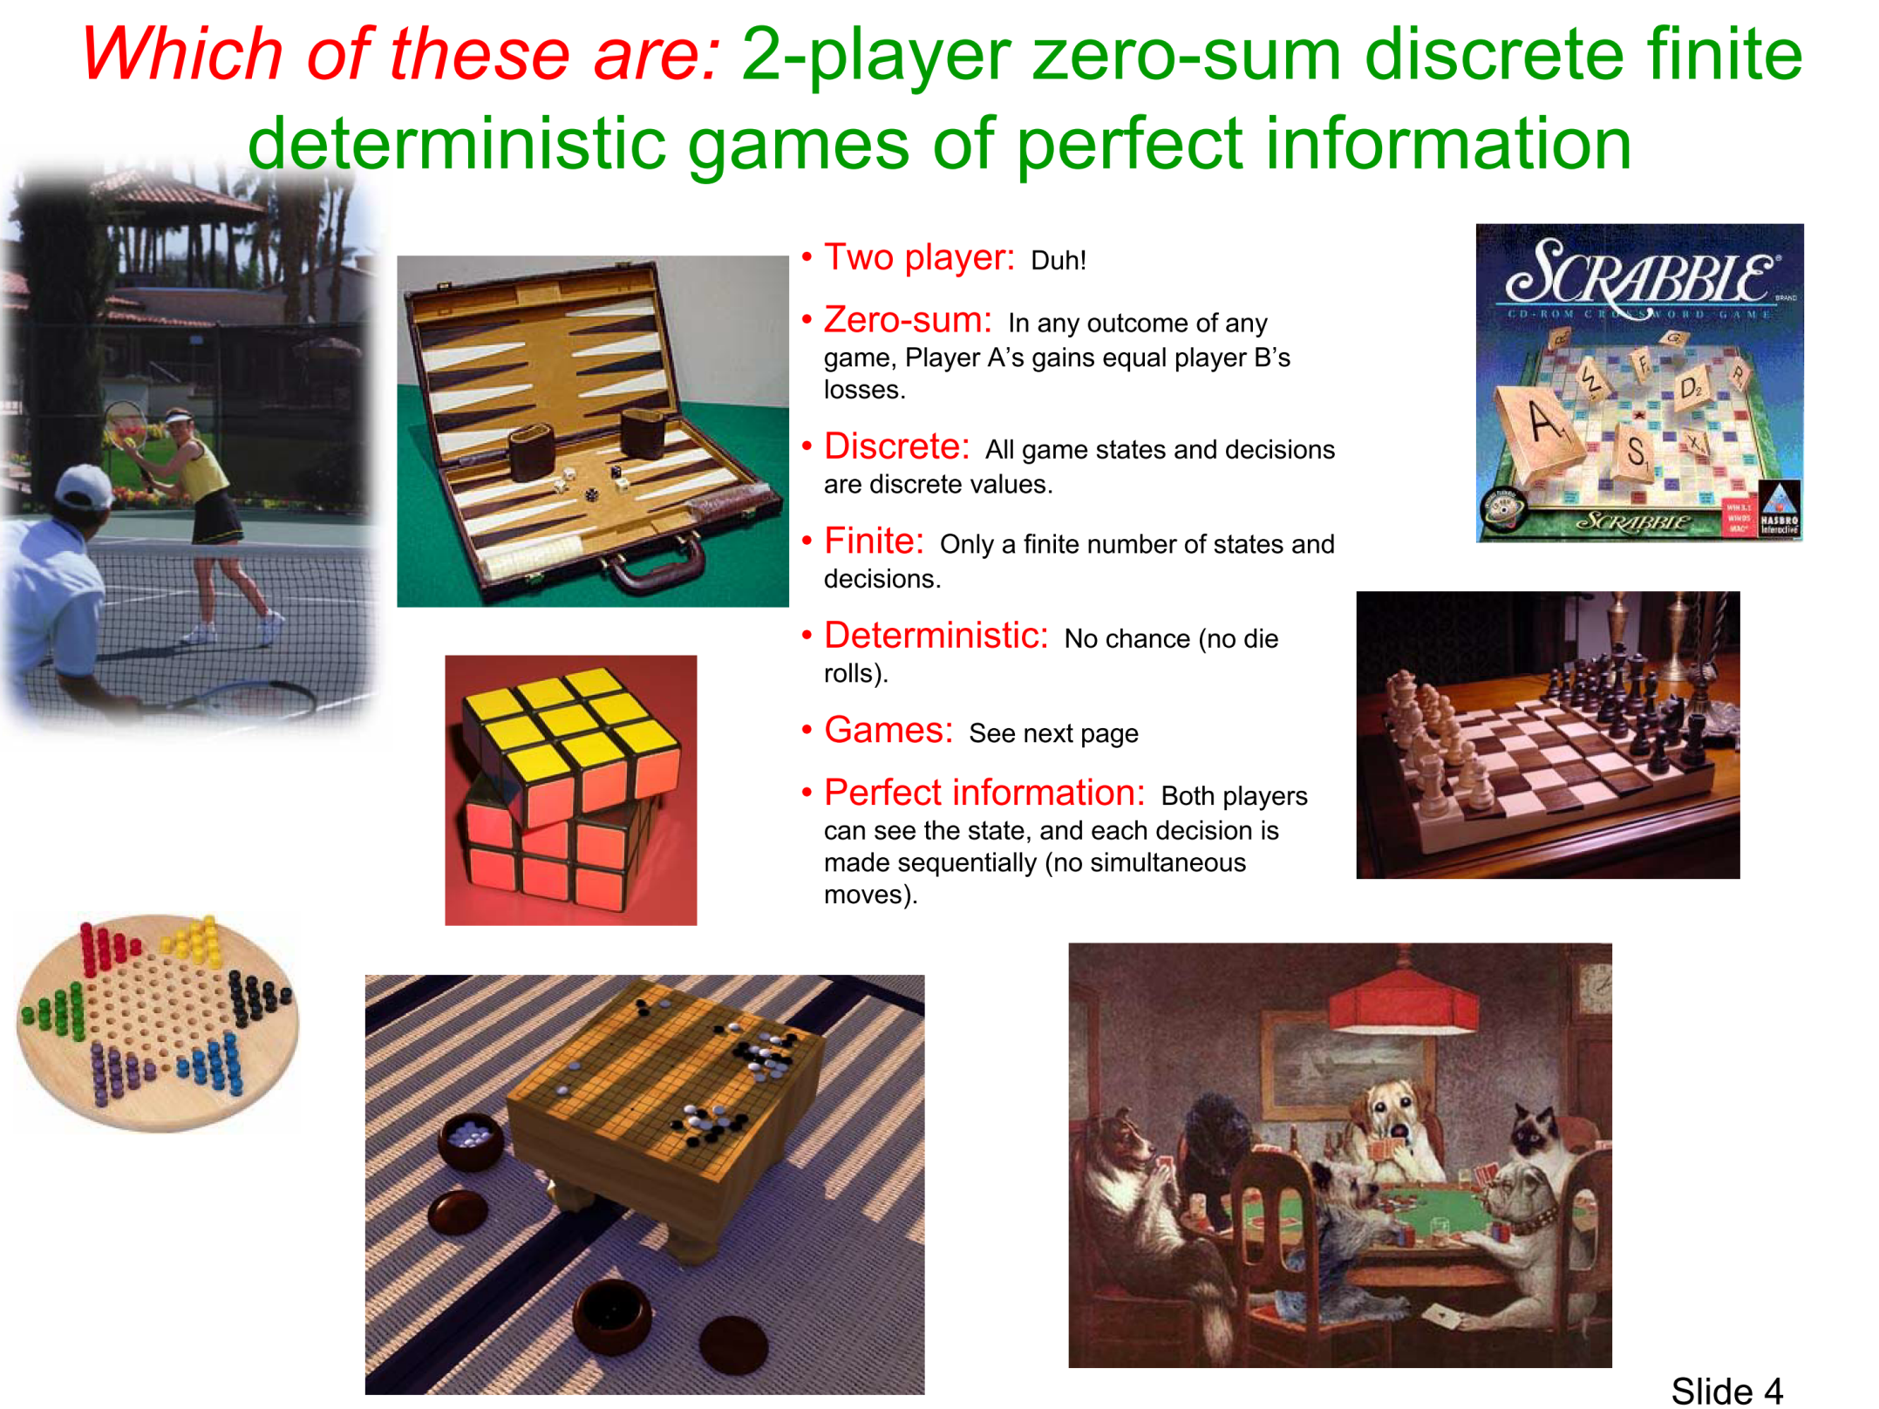

Slide 9
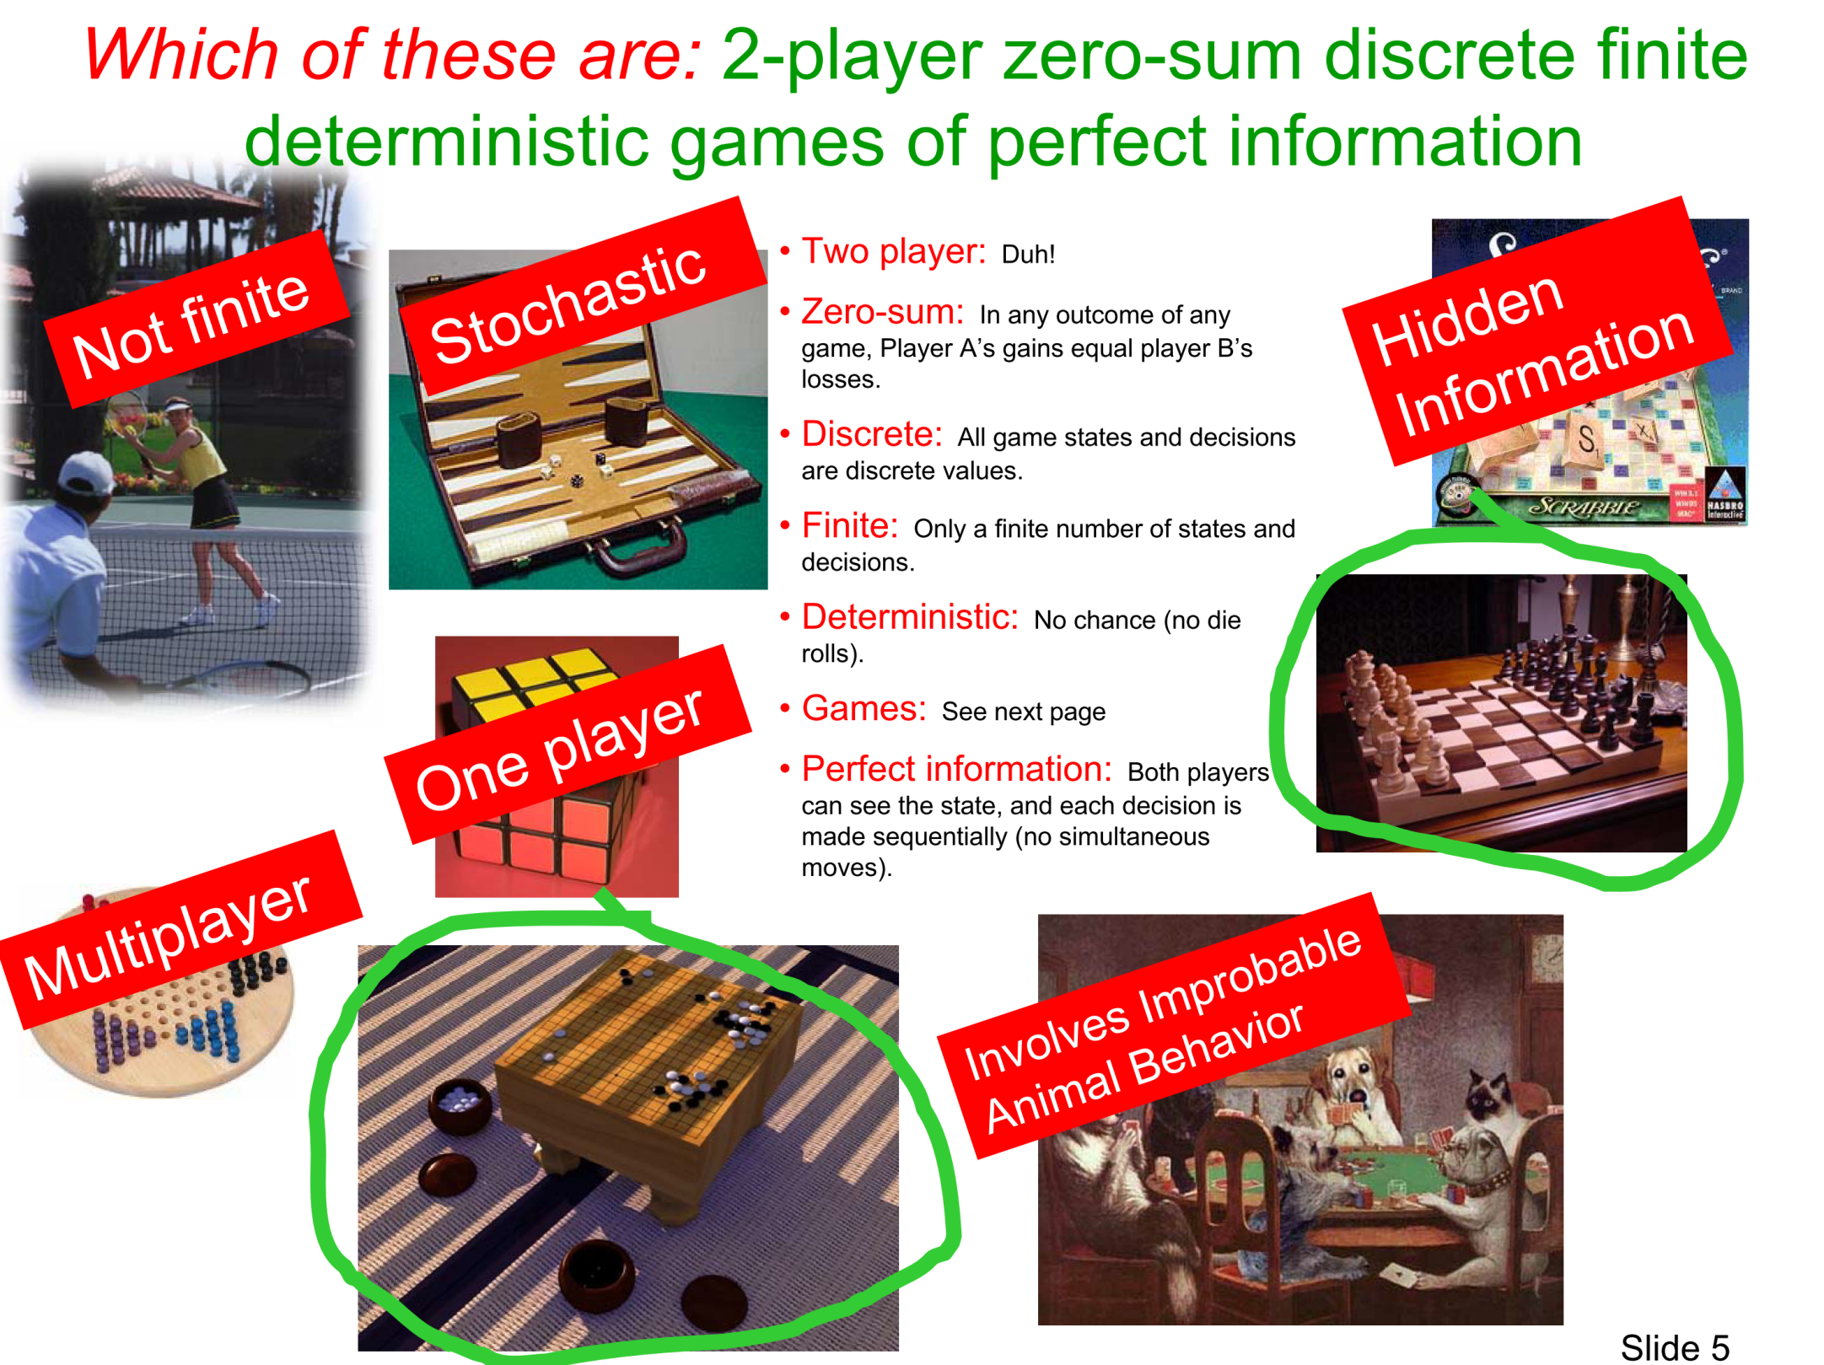

Slide 10
Game Search Formulation
Two players MAX and MIN take turns (with MAX playing first)
State space
Initial state
Successor function
Terminal test
Utility function, that tells whether a terminal state is a win (for MAX), a loss, or a draw
MAX uses search tree to determine next move.

Slide 11
Definition
A Two-player zero-sum discrete finite deterministic game of perfect information is a
quintuplet: ( S , I , Succs , T , V ) where
S
I
Succs
T
V
=
=
=
=
=
a finite set of states (note: state includes information
sufficient to deduce who is due to move)
the initial state
a function which takes a state as input and returns a set of
possible next states available to whoever is due to move
a subset of S. It is the terminal states: the set of states at
which the game is over
a mapping from terminal states to real numbers. It is the
amount that Max wins from Min. (If it’s negative Max loses money
to Min).

Slide 12
Nim
Game: start with a number of piles of tokens
At each turn, a player choose one of the piles, and may pick up one or two tokens from the pile
The player who picks up the last token LOSES

Slide 13
NIM(2,2)
Try the following case:
pile 1
pile 2

Slide 14
Formal description of NIM(2, 2)
( _ , _ )-A
( i , _ )-A
( ii , _ )-A
( _ , _ )-B
( i , _ )-B
( ii , _ )-B
( _ , i )-A
( i , i )-A
( ii , i )-A
( _ , i )-B
( i , i )-B
( ii , i )-B
( _ , ii )-A
( i , ii )-A
( ii , ii )-A
( _ , ii )-B
( i , ii )-B
( ii , ii )-B
S =
( _ , _ )-A ( _ , i )-A ( _ , ii )-A
( i , i )-A ( i , ii )-A
S =
A common trick: By symmetry, some of the states are trivially equivalent (e.g. (_,ii)-A and (ii,_)-A). Make them one state by some canonical description (e.g. left pile never larger than right).
( ii , ii )-A
( _ , _ )-B
( _ , i )-B
( i , i )-B
( _ , ii )-B
( i , ii )-B
( ii , ii )-B

Slide 15
Formal description of NIM(2, 2)
S
=
( _ , _ )-A ( _ , i )-A ( _ , ii )-A ( i , i )-A ( i , ii )-A ( ii , ii )-A
( _ , _ )-B ( _ , i )-B ( _ , ii )-B ( i , i )-B ( i , ii )-B ( ii , ii )-B
I
=
( ii , ii )-A
Succs
=
Succs(_,i)-A = { (_,_)-B }
Succs(_,i)-B = { (_,_)-A }
Succs(_,ii)-A = { (_,_)-B , (_,i)-B }
Succs(i,i)-A = { (_,i)-B }
Succs(_,ii)-B = { (_,_)-A , (_,i)-A }
Succs(i,i)-B = { (_,i)-A }
Succs(i,ii)-A = { (_,i)-B (_,ii)-B (i,i)-B} Succs(i,ii)-B = { (_,i)-A , (_,ii)-A (i,i)-A }
Succs(ii,ii)-A = { (_,ii)-B , (i,ii)-B }
Succs(ii,ii)-B = { (_,ii)-A , (i,ii)-A }
T
=
( _ , _ )-A
( _ , _ )-B
V
=
V( _ , _ )-A = +1
V( _ , _ )-B = -1

Slide 16
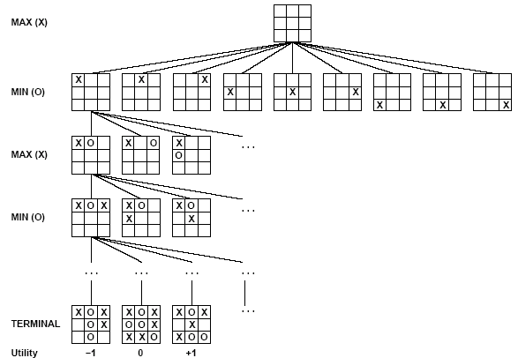
Partial Game Tree for Tic-Tac-Toe

Slide 17
Relation of Games to Search
Search – no adversary
Solution is (heuristic) method for finding goal
Heuristics and CSP techniques can find optimal solution
Evaluation function: estimate of cost from start to goal through given node
Examples: path planning, scheduling activities
Games – adversary
Solution is strategy (strategy specifies move for every possible opponent reply).
Time limits force an approximate solution
Evaluation function: evaluate “goodness” of game position
Examples: chess, checkers, Othello, backgammon

Slide 18
Game Tree for NIM(2,2)
You have a try!

Slide 19
Optimal strategies
Find the contingent（視情況而定的） strategy for MAX assuming an infallible MIN opponent.
Assumption: Both players play optimally !!
Given a game tree, the optimal strategy can be determined by using the minimax value of each node:
MINIMAX-VALUE(n)=
UTILITY(n) If n is a terminal
max_{s ∈ successors(n)} MINIMAX-VALUE(s) If n is a max node
min_{s ∈ successors(n)} MINIMAX-VALUE(s) If n is a min node

Slide 20
Optimal Play
2
2
1
2
7
1
8
2
7
1
8
2
7
1
8
2
This is the optimal play
2
1
MAX
2
7
1
8
MIN
2
7
1
8

Slide 21
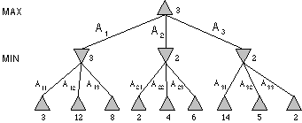
Minimax Tree
MAX node
MIN node
value computed
by minimax
f value

Slide 22
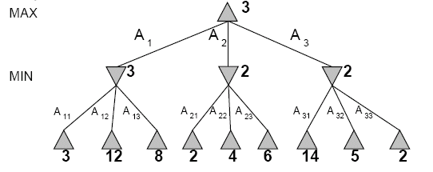
Two-Ply(層) Game Tree

Slide 23
Two-Ply Game Tree

Slide 24
Two-Ply Game Tree

Slide 25
Two-Ply Game Tree
The minimax decision
Minimax maximizes the worst-case outcome for max.

Slide 26
Min-Max Game Tree for NIM(2,2)
You have a try!

Slide 27
What if MIN does not play optimally?
Definition of optimal play for MAX assumes MIN plays optimally: maximizes worst-case outcome for MAX.
But if MIN does not play optimally, MAX can do even better.

Slide 28
Minimax Algorithm
function MINIMAX-DECISION(state) returns an action
inputs: state, current state in game
v←MAX-VALUE(state)
return the action in SUCCESSORS(state) with value v
function MAX-VALUE(state) returns a utility value
if TERMINAL-TEST(state) then return UTILITY(state)
v ← -∞
for a,s in SUCCESSORS(state) do
v ← MAX(v,MIN-VALUE(s))
return v
function MIN-VALUE(state) returns a utility value
if TERMINAL-TEST(state) then return UTILITY(state)
v ← ∞
for a,s in SUCCESSORS(state) do
v ← MIN(v,MAX-VALUE(s))
return v

Slide 29
MiniMax Example
0
5
-3
3
3
-3
0
2
-2
3
5
2
5
-5
0
1
5
1
-3
0
-5
5
-3
3
2

Slide 30
Properties of Minimax
Criterion | Minimax

Slide 31
Properties of Minimax
Criterion | Minimax
Complete?
Optimal?
Time
Space
yes, ☺
in theory…
yes, ☺
O(b^{m}), ☹
O(bm), ☺
b: 分支因子，m: 遊戲樹的最大深度

Slide 32
Problem of minimax search
Number of games states is exponential to the number of moves.
Solution: Do not examine every node
==> Alpha-beta pruning
Remove branches that do not influence final decision

Slide 33
Alpha-beta pruning
We can improve on the performance of the minimax algorithm through alpha-beta pruning
Basic idea: “If you have an idea that is surely bad, don't take the time to see how truly awful it is.” -- Pat Winston
MAX
>=2
We don’t need to compute the value at this node.
No matter what it is, it can’t affect the value of the root node.
MIN
=2
<=1
MAX
2
7
1
?

Slide 34
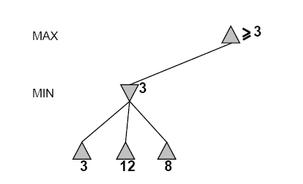
Alpha-Beta Example
Do DF-search until first leaf
Range of possible values
[-∞,+∞]
[-∞, +∞]

Slide 35

Alpha-Beta Example (continued)
[-∞,+∞]
[-∞,3]

Slide 36
Alpha-Beta Example (continued)
[-∞,+∞]
[-∞,3]

Slide 37
Alpha-Beta Example (continued)
[3,+∞]
[3,3]

Slide 38
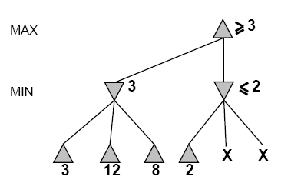
Alpha-Beta Example (continued)
[3,+∞]
This node is worse
for MAX
[3,3]
[-∞,2]

Slide 39
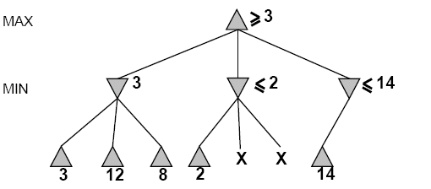
Alpha-Beta Example (continued)
[3,14]
,
[3,3]
[-∞,2]
[-∞,14]

Slide 40
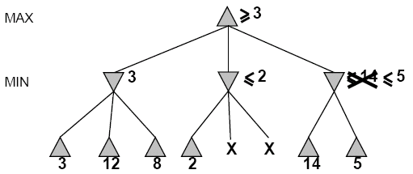
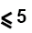
Alpha-Beta Example (continued)
[3,5]
,
[3,3]
[−∞,2]
[-∞,5]

Slide 41
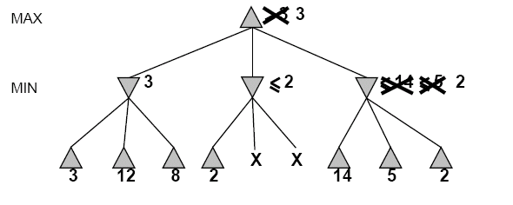
Alpha-Beta Example (continued)
[3,3]
[3,3]
[−∞,2]
[2,2]

Slide 42
Alpha-Beta Example (continued)
[3,3]
[3,3]
[-∞,2]
[2,2]

Slide 43
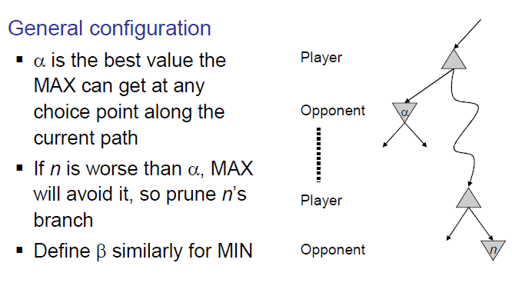
α-β Pruning

Slide 44
Alpha-Beta Algorithm
function ALPHA-BETA-SEARCH(state) returns an action
inputs: state, current state in game
v←MAX-VALUE(state, - ∞ , +∞)
return the action in SUCCESSORS(state) with value v
function MAX-VALUE(state,α , β) returns a utility value
if TERMINAL-TEST(state) then return UTILITY(state)
v ← - ∞
for a,s in SUCCESSORS(state) do
v ← MAX(v,MIN-VALUE(s, α , β))
if v ≥ β then return v
α ← MAX(α ,v)
return v
α : best score (highest) for Max along path to state
β : best score (lowest) for Min along path to state

Slide 45
Alpha-Beta Algorithm
function MIN-VALUE(state, α , β) returns a utility value
if TERMINAL-TEST(state) then return UTILITY(state)
v ← + ∞
for a,s in SUCCESSORS(state) do
v ← MIN(v,MAX-VALUE(s, α , β))
if v ≤ α then return v
β ← MIN(β ,v)
return v

Slide 46
Alpha-Beta Example
0
5
-3
3
3
-3
0
2
-2
3
5
2
5
-5
0
1
5
1
-3
0
-5
5
-3
3
2

Slide 47
Alpha-Beta Example
1.
2.
3.
10.
4.
11.
5.
8.
12.
6.
7.
9.
13.
0
5
-3
3
3
-3
0
2
-2
3
5
2
5
-5
0
1
5
1
-3
0
-5
5
-3
3
2

Slide 48
Comments: Alpha-Beta Pruning
Pruning does not affect final results
Entire subtrees can be pruned.
Good move ordering improves effectiveness of pruning
With “perfect ordering,” time complexity is O(b^{m/2})
Branching factor of sqrt(b) !!
Alpha-beta pruning can look twice as far as minimax in the same amount of time
Repeated states are again possible.
Store them in memory = transposition table

Slide 49
Imperfect Real-time Decisions
In general the search tree is too big to make it possible to reach the terminal states!
Examples:
Checkers: ~10⁴⁰ nodes
Chess: ~10¹²⁰ nodes
SHANNON (1950):
Cut off search earlier (replace TERMINAL-TEST by CUTOFF-TEST)
Apply heuristic evaluation function EVAL (replacing utility function of alpha-beta)

Slide 50
Cutting off search
Change:
if TERMINAL-TEST(state) then return UTILITY(state)
into
if CUTOFF-TEST(state,depth) then return EVAL(state)
Introduces a fixed-depth limit depth
The depth is selected so that the amount of time will not exceed what the rules of the game allow.
When cuttoff occurs, the evaluation is performed.

Slide 51
Evaluation function
Evaluation function or static evaluator is used to evaluate the “goodness” of a game position.
Contrast with heuristic search where the evaluation function was a non-negative estimate of the cost from the start node to a goal and passing through the given node
The zero-sum assumption allows us to use a single evaluation function to describe the goodness of a board with respect to both players.
f(n) >> 0: position n is good for me and bad for you
f(n) << 0: position n is bad for me and good for you
f(n) near 0: position n is a neutral position
f(n) = +infinity: win for me
f(n) = -infinity: win for you

Slide 52
Evaluation function examples
Example of an evaluation function for Tic-Tac-Toe:
f(n) = [# of 3-lengths open for me] - [# of 3-lengths open for you]
where a 3-length is a complete row, column, or diagonal
Alan Turing’s function for chess
f(n) = w(n)/b(n) where w(n) = sum of the point value of white’s pieces and b(n) = sum of black’s
Most evaluation functions are specified as a weighted sum of position features:
f(n) = w₁*feat₁(n) + w₂*feat₂(n) + ... + w_{n}*feat_{k}(n)
Example features for chess are piece count, piece placement, squares controlled, etc.
Deep Blue has about 6000 features in its evaluation function

Slide 53
Adaptive Search (我也不明白☹)
Wait for quiescence(靜止) vs. hot spots
Horizon effect
Extend singular nodes /Secondary search

Slide 54
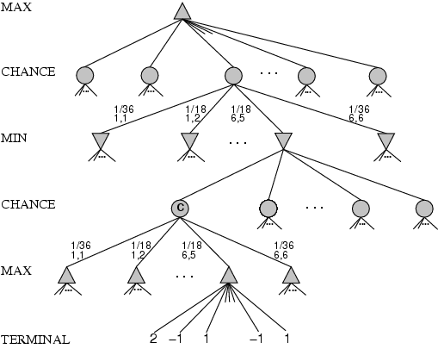
Games that include chance
White has rolled (6,5)
Possible moves (5-10,5-11), (5-11,19-24),(5-10,10-16) and (5-11,11-16)

Slide 55
Games that include chance
chance nodes
Possible moves (5-10,5-11), (5-11,19-24),(5-10,10-16) and (5-11,11-16)
[1,1], [6,6] chance …, all other chance …

Slide 56
Games that include chance
chance nodes
Possible moves (5-10,5-11), (5-11,19-24),(5-10,10-16) and (5-11,11-16)
[1,1], [6,6] chance 1/36, all other chance 1/18

Slide 57
Games that include chance
[1,1], [6,6] chance 1/36, all other chance 1/18
Can not calculate definite minimax value, only expected value

Slide 58
Expected minimax value
EXPECTEDMINIMAX (n)=
UTILITY(n) If n is a terminal
max_{s ∈ successors(n)} EXPECTEDMINIMAX(s) If n is a max node
min_{s ∈ successors(n)} EXPECTEDMINIMAX(s) If n is a min node
∑_{s ∈ successors(n)} P(s) * EXPECTEDMINIMAX(s) If n is a chance node
These equations can be backed-up recursively all the way to the root of the game tree.

Slide 59
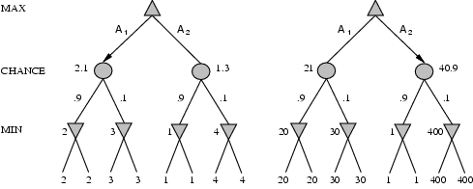
Evaluation with chance nodes
Left, A1 wins
Right A2 wins
Outcome of evaluation function should not change when values are scaled differently.
Behavior is preserved only by a positive linear transformation of EVAL.

Slide 60
Several Examples……

Slide 61
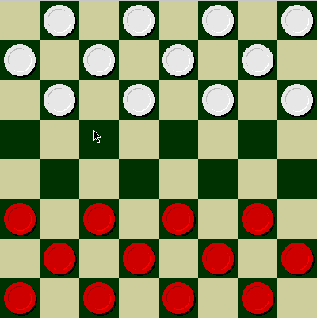
Checkers
© Jonathan Schaeffer

Slide 62
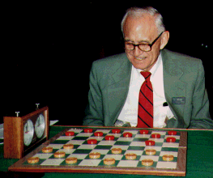
Chinook vs. Tinsley
Name: Marion Tinsley
Profession: Teach
mathematics
Hobby: Checkers
Record: Over 42 years
loses only 3 (!)
games of checkers
© Jonathan Schaeffer

Slide 63

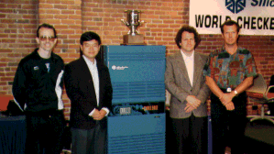
Chinook
First computer to win human world championship!
Visit http://www.cs.ualberta.ca/~chinook/ to play a
version of Chinook over the Internet.

Slide 64
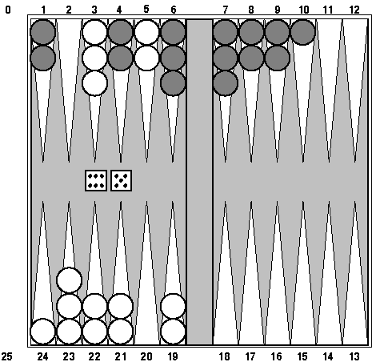
Backgammon
branching factor several hundreds
TD-Gammon v1 – 1-step look ahead, learns to play games against itself
TD-Gammon v2.1 – 2-ply search, does well against world champions
TD-Gammon has changed the way experts play backgammon.

Slide 65
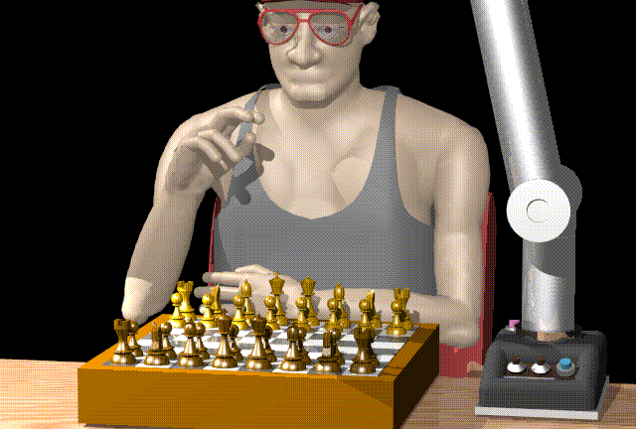
Chess

Slide 66
Man vs. Machine
Kasparov
5’10”
176 lbs
34 years
50 billion neurons
2 pos/sec
Extensive
Electrical/chemical
Enormous
Name
Height
Weight
Age
Computers
Speed
Knowledge
Power Source
Ego(自我意識)
Deep Blue
6’ 5”
2,400 lbs
4 years
512 processors
200,000,000 pos/sec
Primitive
Electrical
None
© Jonathan Schaeffer

Slide 67
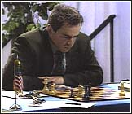
Chess
Name: Garry Kasparov
Title: World Chess
Champion
Crime: Valued greed
over common sense
© Jonathan Schaeffer

Slide 68
Several versions of the story…
http://www.research.ibm.com/deepblue/home/may11/story_1.html
http://www.columbia.edu/cu/moment/041796/deepblue.html
http://www.wired.com/wired/archive/9.10/chess.html?pg=2&topic=&topic_set=
http://www.byte.com/art/9707/sec6/art6.htm

Slide 69
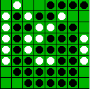
Reversi/Othello
© Jonathan Schaeffer

Slide 70
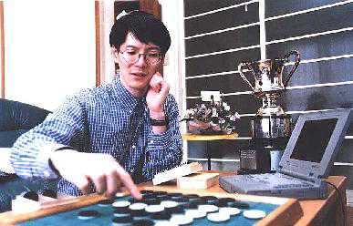
Othello
Name: Takeshi
Murakami
Title: World
Othello Champion
Crime: Man crushed
by machine
© Jonathan Schaeffer

Slide 71
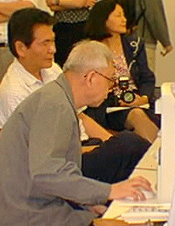
Go: On the One Side
Name: Chen Zhixing
Author: Handtalk (Goemate)
Profession: Retired
Computer skills: self-
taught assembly
language programmer
Accomplishments:
dominated computer go
for 4 years.
© Jonathan Schaeffer

Slide 72
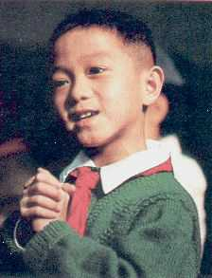
Go: And on the Other
Gave Handtalk a 9 stone
Handicap(讓九子) and still easily
beat the program,
thereby winning $15,000
© Jonathan Schaeffer

Slide 73
Perspective on Games: Pro
“Saying Deep Blue doesn’t really think about chess is like saying an airplane doesn't really fly because it doesn't flap its wings”
Drew McDermott
© Jonathan Schaeffer

Slide 74
Perspective on Games: Con
“Chess is the Drosophila(果蠅) of artificial intelligence. However, computer chess has developed much as genetics might have if the geneticists had concentrated their efforts starting in 1910 on breeding racing Drosophila. We would have some science, but mainly we would have very fast fruit flies.”
John McCarthy
© Jonathan Schaeffer

Slide 75
Alternative Approaches
The standard approach, based on mini-max, evaluation functions, and alpha—beta, has been worked on for so long, it dominates other methods in game play.
Some believe that this has caused game playing to become divorced from the main-stream of Al research: the standard approach no longer provides much room for new insight into general questions of decision making.

Slide 76
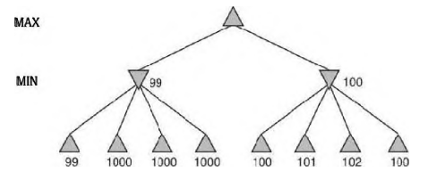
Alternative Approaches
Problems with heuristic minimax

Slide 77
Alternative Approaches
The aim of an algorithm designer is to specify a computation that runs quickly and yields a good move.
The alpha—beta algorithm is designed not just to select a good move but also to calculate bounds on the values of all the legal moves.
How about a position in which there is only one legal move?
There is one obviously good move and several moves that are legal but lead to a quick loss.

Slide 78
Alternative Approaches
Utility of a node expansion: A good search algorithm should select node expansions of high utility—that is, ones that are likely to lead to the discovery of a significantly better move. If there are no node expansions whose utility is higher than their cost (in terms of time), then the algorithm should stop searching and make a move.
meta-reasoning (reasoning about reasoning).

Slide 79
Summary
Games illustrate several important points about AI
Perfection is unattainable -> approximation
Good idea what to think about what to think about
Heuristics can help
Problem Formulation: Game tree
Minimax procedure
Alpha-beta procedure

Slide 80
Additional Resources
Game AI Page

Slide 81
Alpha-Beta Example
0
5
-3
3
3
-3
0
2
-2
3
5
2
5
-5
0
1
5
1
-3
0
-5
5
-3
3
2

Slide 82
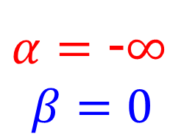
Alpha-Beta Example
$α=$ -$∞$
$$β=0$$
0
0
5
-3
3
3
-3
0
2
-2
3
5
2
5
-5
0
1
5
1
-3
0
-5
5
-3
3
2

Slide 83
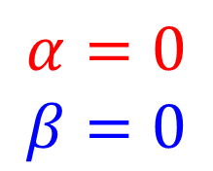
Alpha-Beta Example
$$α=0$$
$$β=0$$
0
0
0
5
-3
3
3
-3
0
2
-2
3
5
2
5
-5
0
1
5
1
-3
0
-5
5
-3
3
2

Slide 84
Alpha-Beta Example
$$α=0$$
$$β=0$$
0
0
-3
0
5
-3
3
3
-3
0
2
-2
3
5
2
5
-5
0
1
5
1
-3
0
-5
5
-3
3
2

Slide 85
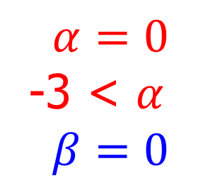
Alpha-Beta Example
$$α=0$$
-3 < $α$
$$β=0$$
0
0
-3
0
5
-3
3
3
-3
0
2
-2
3
5
2
5
-5
0
1
5
1
-3
0
-5
5
-3
3
2

Slide 86
Alpha-Beta Example
0
$$α=0$$
$$β=0$$
0
0
-3
0
5
-3
3
3
-3
0
2
-2
3
5
2
5
-5
0
1
5
1
-3
0
-5
5
-3
3
2

Slide 87
Alpha-Beta Example
0
$$α=0$$
$$β=0$$
0
3
0
-3
3
0
5
-3
3
3
-3
0
2
-2
3
5
2
5
-5
0
1
5
1
-3
0
-5
5
-3
3
2

Slide 88
Alpha-Beta Example
0
0
3
0
-3
3
0
5
-3
3
3
-3
0
2
-2
3
5
2
5
-5
0
1
5
1
-3
0
-5
5
-3
3
2

Slide 89
Alpha-Beta Example
0
0
0
0
3
0
-3
3
0
5
-3
3
3
-3
0
2
-2
3
5
2
5
-5
0
1
5
1
-3
0
-5
5
-3
3
2

Slide 90
Alpha-Beta Example
0
0
0
0
3
0
-3
3
5
0
5
-3
3
3
-3
0
2
-2
3
5
2
5
-5
0
1
5
1
-3
0
-5
5
-3
3
2

Slide 91
Alpha-Beta Example
0
0
0
0
3
2
0
-3
3
2
0
5
-3
3
3
-3
0
2
-2
3
5
2
5
-5
0
1
5
1
-3
0
-5
5
-3
3
2

Slide 92
Alpha-Beta Example
0
0
0
0
3
2
0
-3
3
2
0
5
-3
3
3
-3
0
2
-2
3
5
2
5
-5
0
1
5
1
-3
0
-5
5
-3
3
2

Slide 93
Alpha-Beta Example
0
0
2
0
2
0
3
2
0
-3
3
2
0
5
-3
3
3
-3
0
2
-2
3
5
2
5
-5
0
1
5
1
-3
0
-5
5
-3
3
2

Slide 94
Alpha-Beta Example
0
0
2
0
2
0
3
2
0
-3
3
2
0
5
-3
3
3
-3
0
2
-2
3
5
2
5
-5
0
1
5
1
-3
0
-5
5
-3
3
2

Slide 95
Alpha-Beta Example
0
0
0
2
0
2
0
3
2
0
-3
3
2
0
5
-3
3
3
-3
0
2
-2
3
5
2
5
-5
0
1
5
1
-3
0
-5
5
-3
3
2

Slide 96
Alpha-Beta Example
0
0
0
2
0
2
0
3
2
0
-3
3
2
5
0
5
-3
3
3
-3
0
2
-2
3
5
2
5
-5
0
1
5
1
-3
0
-5
5
-3
3
2

Slide 97
Alpha-Beta Example
0
0
0
2
0
2
0
3
2
1
0
-3
3
2
1
0
5
-3
3
3
-3
0
2
-2
3
5
2
5
-5
0
1
5
1
-3
0
-5
5
-3
3
2

Slide 98
Alpha-Beta Example
0
0
0
2
0
2
0
3
2
1
0
-3
3
2
1
-3
0
5
-3
3
3
-3
0
2
-2
3
5
2
5
-5
0
1
5
1
-3
0
-5
5
-3
3
2

Slide 99
Alpha-Beta Example
0
0
0
2
0
2
0
3
2
1
0
-3
3
2
1
-3
0
5
-3
3
3
-3
0
2
-2
3
5
2
5
-5
0
1
5
1
-3
0
-5
5
-3
3
2

Slide 100
Alpha-Beta Example
0
0
0
2
1
0
2
1
0
3
2
1
0
-3
3
2
1
-3
0
5
-3
3
3
-3
0
2
-2
3
5
2
5
-5
0
1
5
1
-3
0
-5
5
-3
3
2

Slide 101
Alpha-Beta Example
0
0
0
2
1
0
2
1
0
3
2
1
0
-3
3
2
1
-3
-5
0
5
-3
3
3
-3
0
2
-2
3
5
2
5
-5
0
1
5
1
-3
0
-5
5
-3
3
2

Slide 102
Alpha-Beta Example
0
0
0
2
1
0
2
1
0
3
2
1
0
-3
3
2
1
-3
-5
0
5
-3
3
3
-3
0
2
-2
3
5
2
5
-5
0
1
5
1
-3
0
-5
5
-3
3
2

Slide 103
Alpha-Beta Example
0
0
0
2
1
0
2
1
-5
0
3
2
1
-5
0
-3
3
2
1
-3
-5
0
5
-3
3
3
-3
0
2
-2
3
5
2
5
-5
0
1
5
1
-3
0
-5
5
-3
3
2

Slide 104
Alpha-Beta Example
0
0
0
2
1
0
2
1
-5
0
3
2
1
-5
0
-3
3
2
1
-3
-5
0
5
-3
3
3
-3
0
2
-2
3
5
2
5
-5
0
1
5
1
-3
0
-5
5
-3
3
2

Slide 105
Alpha-Beta Example
1
0
1
0
2
1
0
2
1
-5
0
3
2
1
-5
0
-3
3
2
1
-3
-5
0
5
-3
3
3
-3
0
2
-2
3
5
2
5
-5
0
1
5
1
-3
0
-5
5
-3
3
2

Slide 106
Alpha-Beta Example
1
0
1
0
2
1
2
0
2
1
-5
2
0
3
2
1
-5
2
0
-3
3
2
1
-3
-5
2
0
5
-3
3
3
-3
0
2
-2
3
5
2
5
-5
0
1
5
1
-3
0
-5
5
-3
3
2

Slide 107
Alpha-Beta Example
1
0
1
0
2
1
2
0
2
1
-5
2
0
3
2
1
-5
2
0
-3
3
2
1
-3
-5
2
0
5
-3
3
3
-3
0
2
-2
3
5
2
5
-5
0
1
5
1
-3
0
-5
5
-3
3
2

